Slide 1
“Why Should I Care?”
Climate, Intersectionality, and Connecting the Dots
Robin Zheng
University of Glasgow
philosophersforsustainability.com

Slide 2
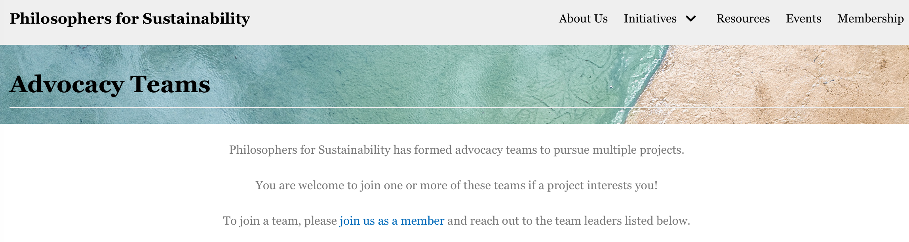
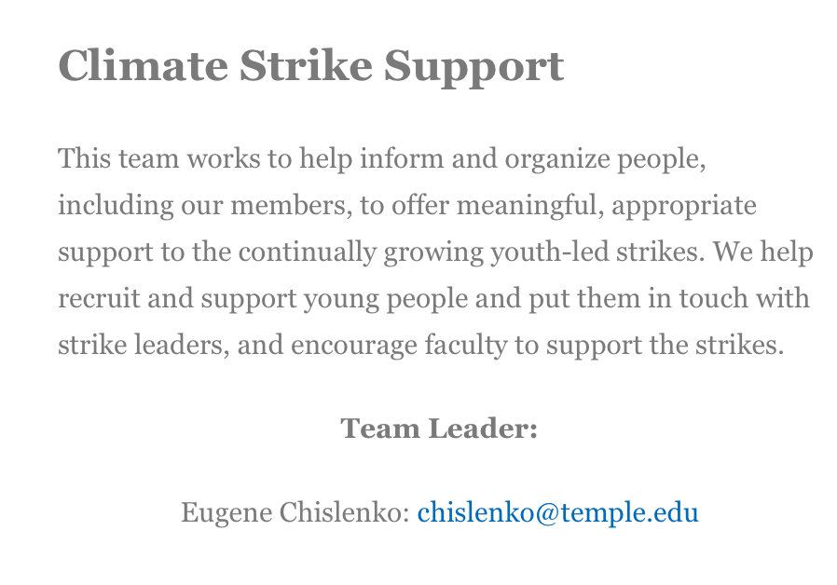

Slide 3


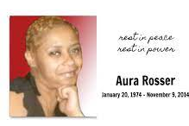


Slide 4
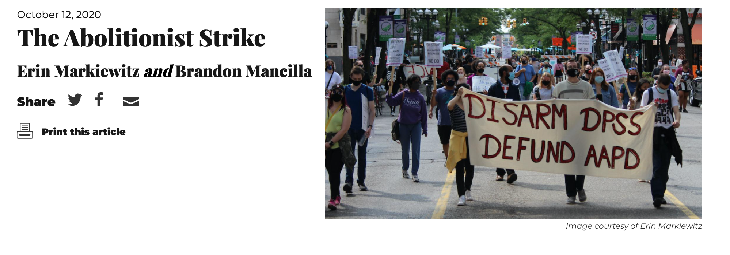

Slide 5
“How is this a labor issue?”

Slide 6
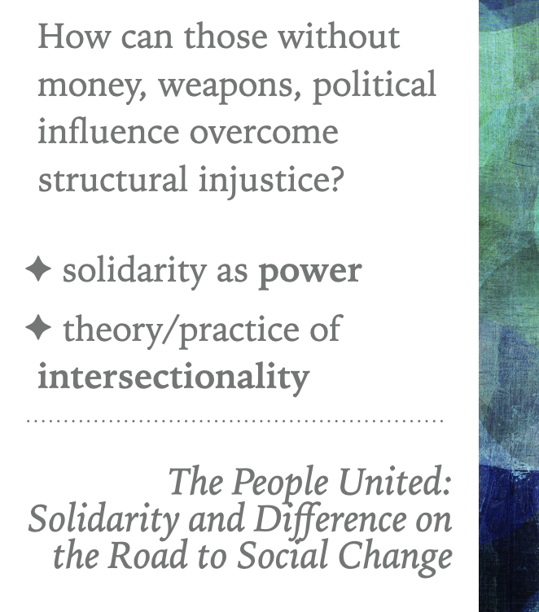
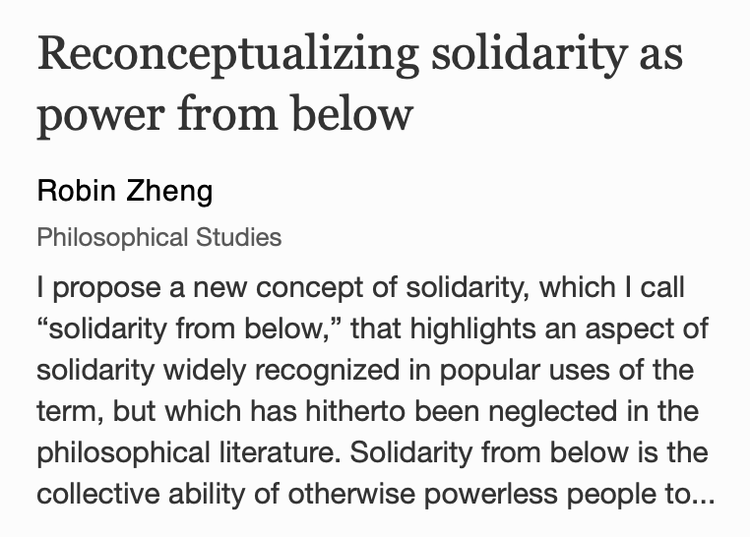

Slide 7
Intersectionality is the key to unlocking the power of solidarity
Divide and conquer
Building solidarity (i.e., collective power)
“Not My Issue”
BUT, usually either too bird’s eye or too granular

Slide 8
What does an organizer need to know in order to persuade her constituency of the moral and strategic imperative to act in solidarity with other movements?
What answers would she want to have, ready to hand, if she is asked: “Why should we care about X?”

Slide 9
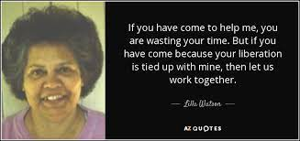
What does an organizer need to know in order to persuade her constituency of the moral and strategic imperative to act in solidarity with other movements?
What answers would she want to have, ready to hand, if she is asked: “Why should we care about X?”
+ Factual gaps
+ Critical analyses

Slide 10
Collecting arguments
Conceptual
Political
Pragmatic

Slide 11
Collecting arguments
Conceptual
Political
Pragmatic
Genetic -- Y causally contributes to X
Functional -- X plays a functional role in the processes of Y
Intensification -- Y makes X worse
Isomorphic -- Y exhibits structural parallels with X

Slide 12
Collecting arguments
Conceptual
Political
Pragmatic
Hypocrisy -- X is committed to some ideal A but fails to do what is required to achieve A
Scapegoating -- X is oppressed by Z but blames B for it
Pressure/Safety valve -- X copes with being oppressed by Z by similarly dominating (‘taking it out on’) C

Slide 13
Collecting arguments
Conceptual
Political
Pragmatic
Co-optation -- Efforts to address X are co-opted by Y
Undermining -- Failure to address Y undermines efforts to rectify X
Divide and conquer -- X is used to divide A and B, thereby weakening both movements

Slide 14
Feminism <> Climate Justice

Slide 15

The domination/exploitation of nature is justified by the same conceptual ideology as the domination/exploitation of women.
isomorphic
Francis Bacon: extracting secrets of nature/torturing accused witches
Man as master/rational/controller over women/nature as to-be-subjugated/irrational/uncontrollable
(Maria Mies, Carolyn Merchant)
Notes:
https://invisiblepeople.tv/report-warns-climate-change-threatens-affordable-housing/

Slide 16
The domination/exploitation of nature is justified by the same conceptual ideology as the domination/exploitation of women.
isomorphic
Francis Bacon: extracting secrets of nature/torturing accused witches
Man as master/rational/controller over women/nature as to-be-subjugated/irrational/uncontrollable
(Maria Mies, Carolyn Merchant)
Intensification
Notes:
https://invisiblepeople.tv/report-warns-climate-change-threatens-affordable-housing/

Slide 17
Antiracism <> Climate Justice

Slide 18
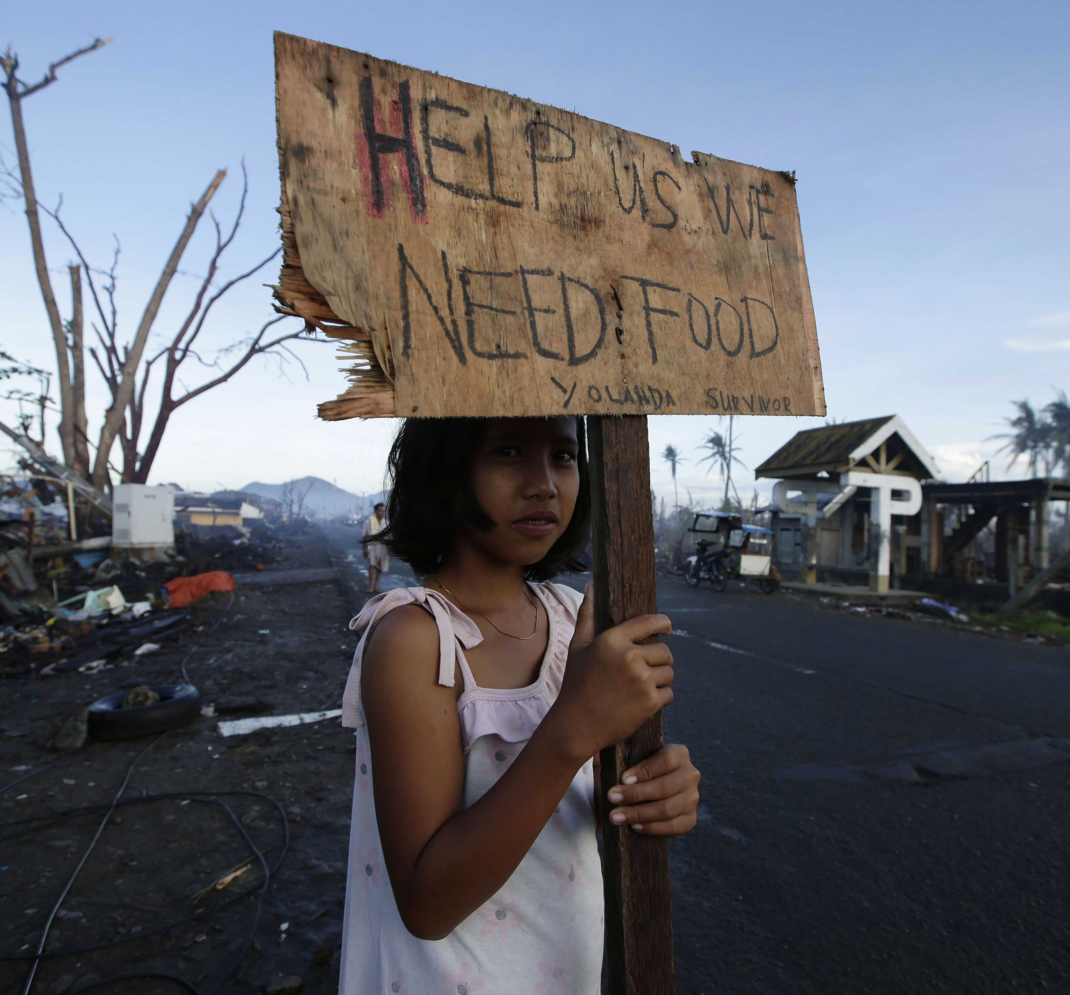
People of color are disproportionately and/or distinctly vulnerable to the harms of climate change and environmental degradation.
intensification
Climate change → climate refugees
Pollution → environmental racism
Extraction → destruction of indigenous homes and livelihoods
Notes:
https://invisiblepeople.tv/report-warns-climate-change-threatens-affordable-housing/

Slide 19
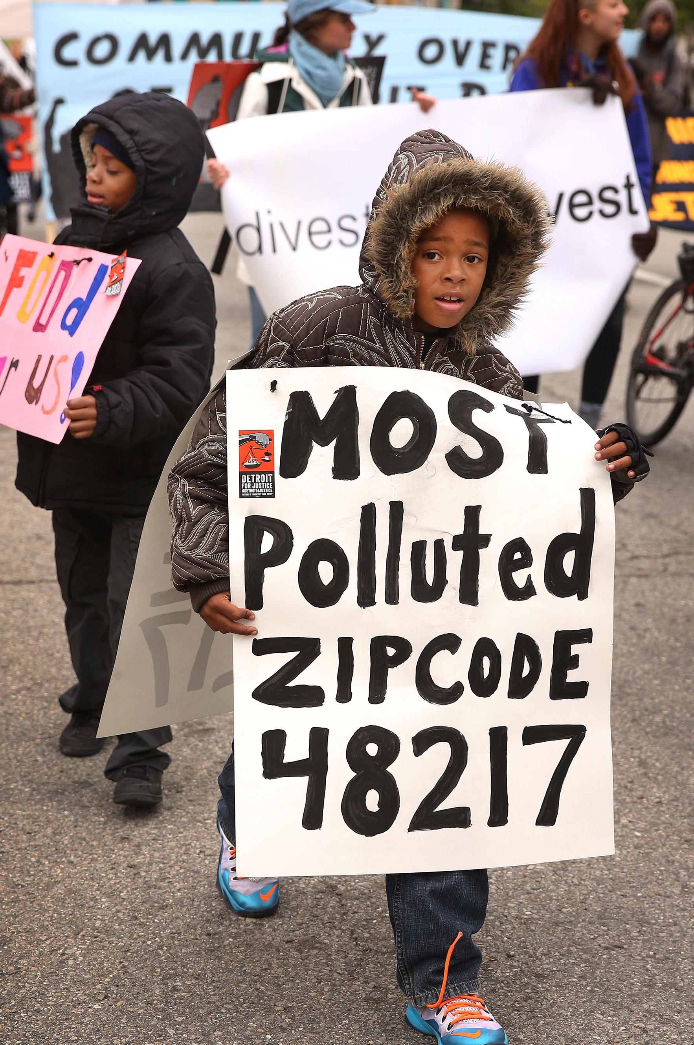
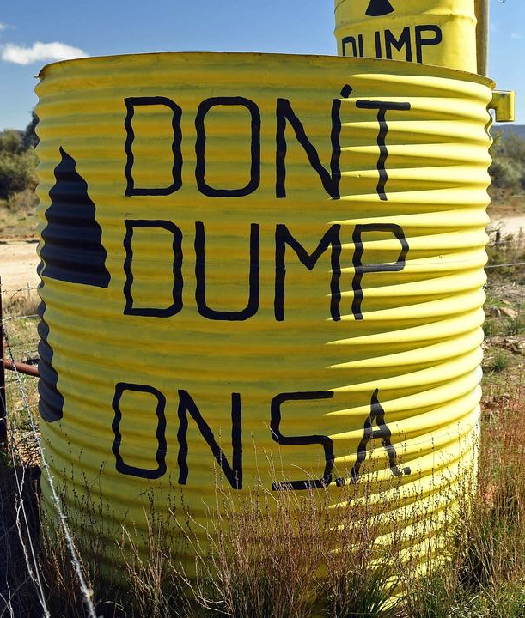
People of color are disproportionately and/or distinctly vulnerable to the harms of climate change and environmental degradation.
intensification
Climate change → climate refugees
Pollution → environmental racism
Extraction → destruction of indigenous homes and livelihoods
Notes:
https://invisiblepeople.tv/report-warns-climate-change-threatens-affordable-housing/

Slide 20
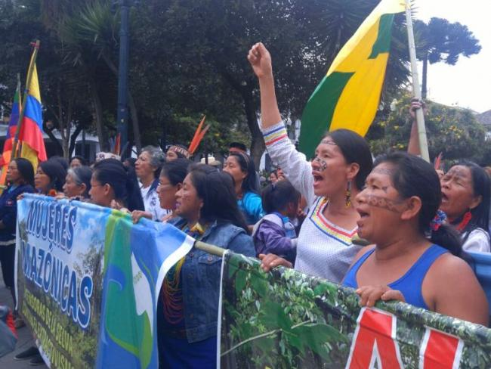
People of color are disproportionately and/or distinctly vulnerable to the harms of climate change and environmental degradation.
intensification
Climate change → climate refugees
Pollution → environmental racism
Extraction → destruction of indigenous homes and livelihoods
Notes:
Drilling, pipelines, deforestation

Slide 21
“You can’t have climate change without sacrifice zones*, and you can’t have sacrifice zones without disposable people, and you can't have disposable people without racism. ”
– Hop Hopkins, “Racism Is Killing Our Planet”
*pollution, nuclear waste, fracked watersheds; islands
functional
Climate change and environmental degradation
result from prioritizing profit over the well-being of
people of color.
Notes:
https://www.sierraclub.org/press-releases/2020/06/sierra-club-op-ed-racism-killing-planet

Slide 22
PFAS contamination from military firefighting substance
Military conflicts disrupt and divert resources away from climate efforts (e.g. Myanmar)
Border walls destroy biodiversity by barricading species/territory
genetic
Climate change and environmental degradation
result from the military and border operations targeting people of color.
Notes:
https://www.sierraclub.org/press-releases/2020/06/sierra-club-op-ed-racism-killing-planet

Slide 23
Leftism <> Climate Justice

Slide 24


Workers, tenants, the poor are disproportionately and/or distinctly vulnerable to the harms of climate change and environmental degradation.
intensification
Climate change → severe weather → unsafe working conditions (drivers)
Deforestation etc. → COVID-19 → unsafe working conditions (service industry)

Slide 25


Workers, tenants, the poor are disproportionately and/or distinctly vulnerable to the harms of climate change and environmental degradation.
intensification
Climate change → floods, fires, hurricanes → housing insecurity
(homelessness, climate gentrification)
Notes:
https://invisiblepeople.tv/report-warns-climate-change-threatens-affordable-housing/

Slide 26
Climate change and environmental degradation
result from prioritizing profit over the well-being of workers, tenants, the poor.
Notes:
http://thefifthestate.com.au/urbanism/environment/construction-runoff-still-a-major-polluter-of-local-waterways/
https://www.huffpost.com/entry/construction-major-pollution-how-we-build-better_n_5ea3464bc5b6f9639814c009

Slide 27
Climate change and environmental degradation result from prioritizing profit over the well-being of workers, tenants, the poor.
Cheap housing → wastes energy
Expensive new housing → construction runoff/pollution, high-emission materials (e.g. concrete)
Notes:
http://thefifthestate.com.au/urbanism/environment/construction-runoff-still-a-major-polluter-of-local-waterways/
https://www.huffpost.com/entry/construction-major-pollution-how-we-build-better_n_5ea3464bc5b6f9639814c009

Slide 28
Toward an Intersectional Climate Activism:

Slide 29
Overcoming divisions
“Lifestyle environmentalism will never win over workers” (Huber)
Environmental narratives reinforce privilege, obscure/hinder the most important environmentalist actors
‘low-carbon gentrification’: need for mobility justice (Sheller)
undermining
hypocrisy, undermining
hypocrisy, undermining

Slide 30
Moving forward
Workers are the same people in the factory and in their climate-threatened homes (Jane McAlevey on ‘whole worker organizing’), so labor and climate activists have the same enemy: capitalism (Labor4Sustainability)
Reparations = climate justice (Taiwo, Reconsidering Reparations)
Water issues are good for uniting rural vs. urban divide
Feminist carework is green work! (eg. Naomi Klein)
‘Shale Must Fall’, Zero Hour: anticolonial environmentalists of color (environmental justice more broadly)

Slide 31
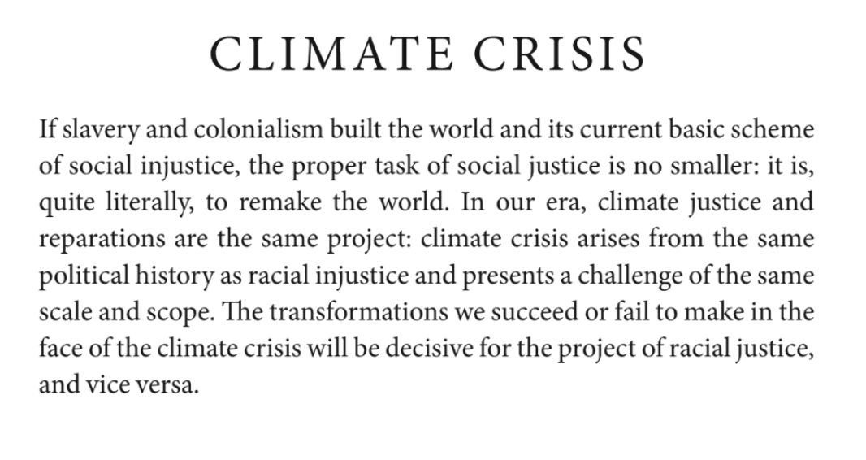
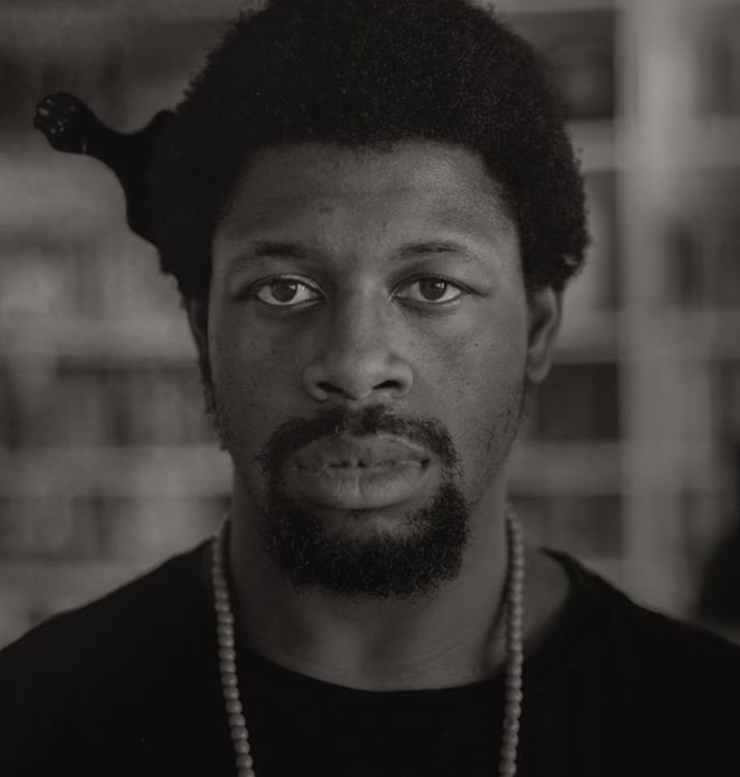
Because Femi says so

Slide 32
Building the collective power of women, workers, tenants, (indigenous) people of color is the prerequisite to all climate solutions!

